Slide 1

Females of Color Performance Update
Council of Great City Schools
September 2021

Slide 2
Data Sources
NAEP Trend Data: 2011-2019
  U.S. Department of Education, Institute of Education Sciences, National Center for Education Statistics, National Assessment of Educational Progress (NAEP), available at https://nces.ed.gov/nationsreportcard/data/
CGCS KPI Data: 2016-2019
  Council of Great City Schools, Academic Key Performance Indicators, 2016–2019
  Office of Civil Rights Data: 2012-2018
  U.S. Department of Education, Office for Civil Rights, Civil Rights Data Collection, 2017-18, available at http://ocrdata.ed.gov

Slide 3
NAEP Trend Data: 2011-2019
Comparisons are made between large city and national public schools as well as by race.

Slide 4
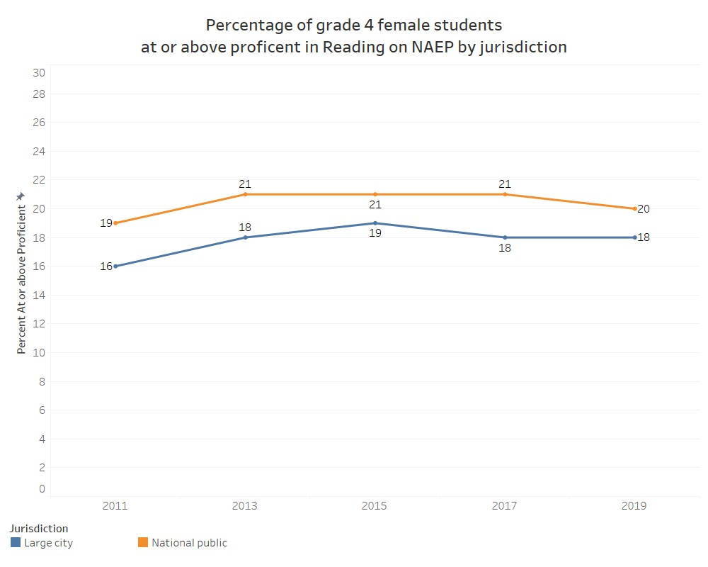
NAEP
GRADE 4 Reading Performance
of Females by Jurisdiction

Slide 5
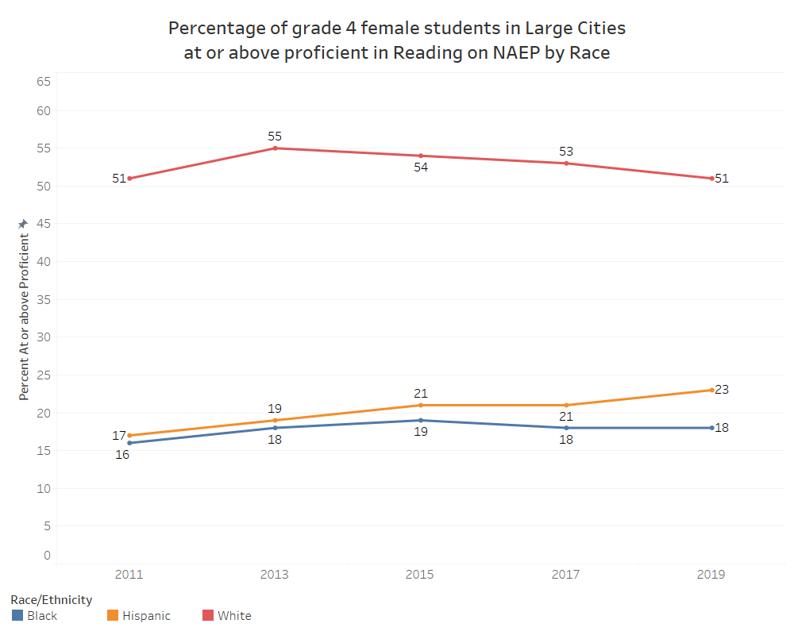
NAEP
GRADE 4 Reading Performance
of Females in Large Cities by Race

Slide 6
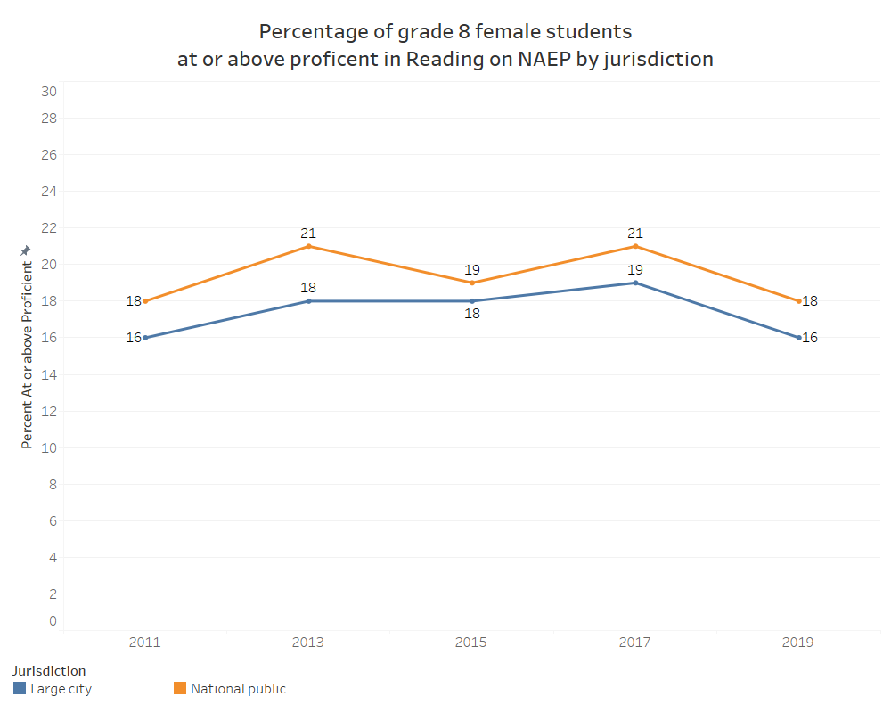
NAEP
GRADE 8 Reading Performance
of Females by Jurisdiction

Slide 7
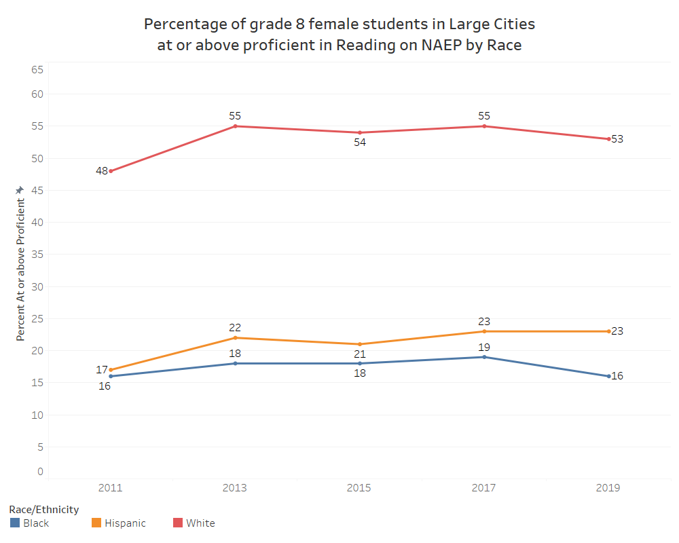
NAEP
GRADE 8 Reading Performance
of Females in Large Cities by Race

Slide 8
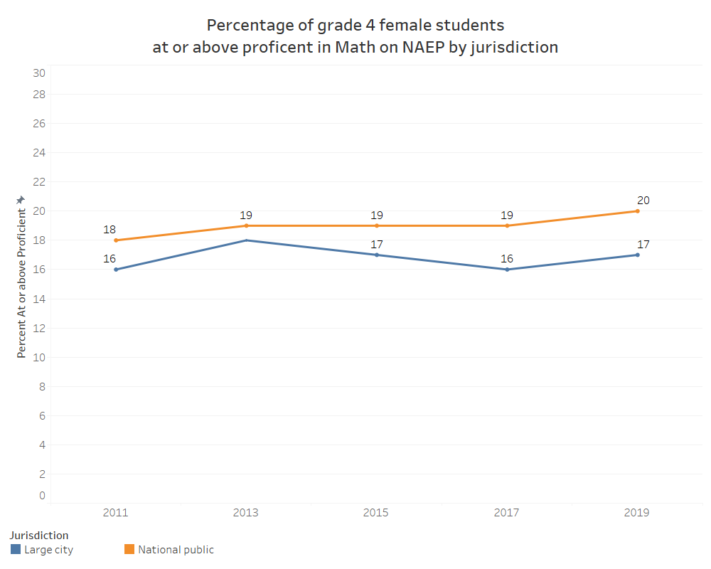
NAEP
GRADE 4 Math Performance
of Females by Jurisdiction

Slide 9
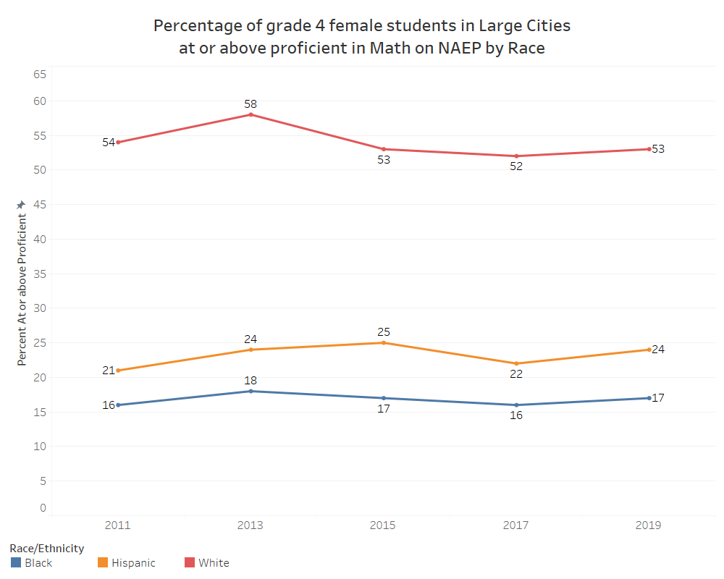
NAEP
GRADE 4 Math Performance
of Females in Large Cities by Race

Slide 10
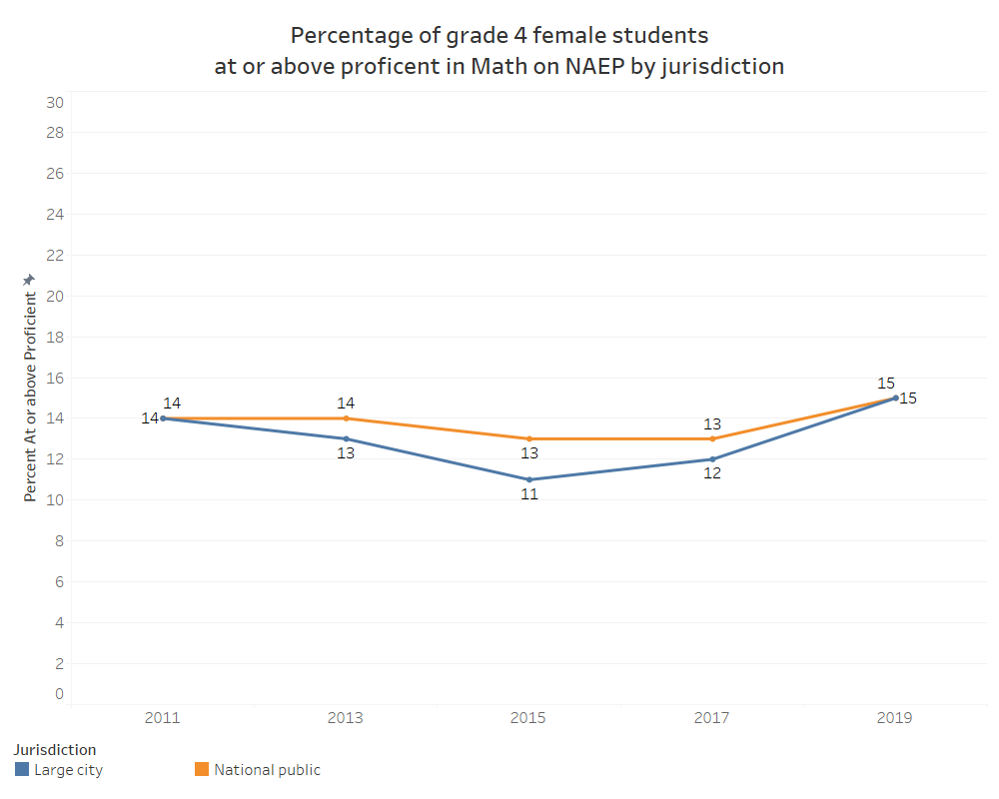
NAEP
GRADE 8 Math Performance
of Females by Jurisdiction

Slide 11
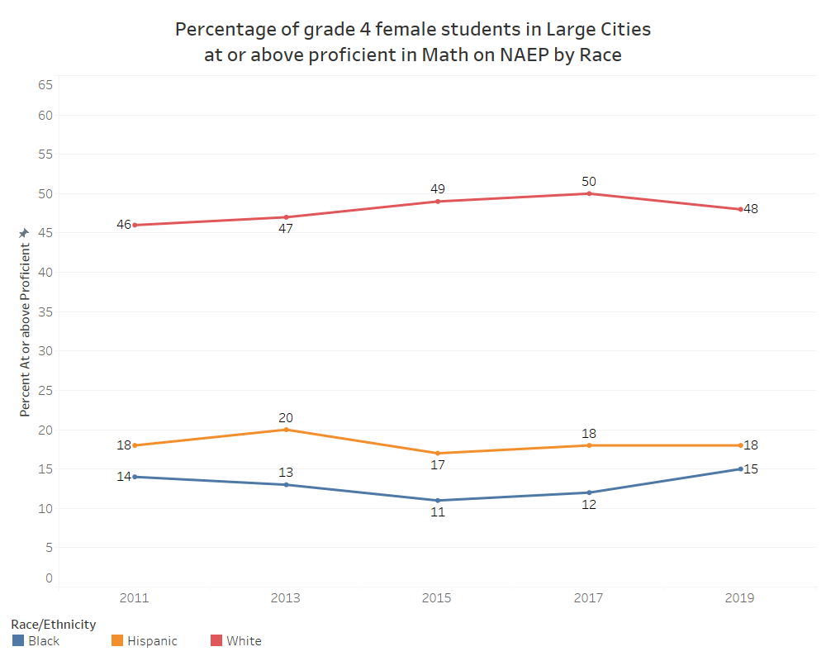
NAEP
GRADE 8 Math Performance
of Females in Large Cities by Race

Slide 12
  Office of Civil Rights Data: 2012-2018
  Data provided on public schools nationwide.

Slide 13
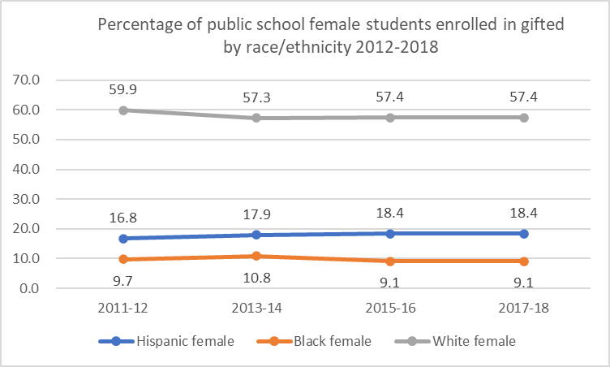
Female Students Enrolled in Gifted Courses by Race

Slide 14
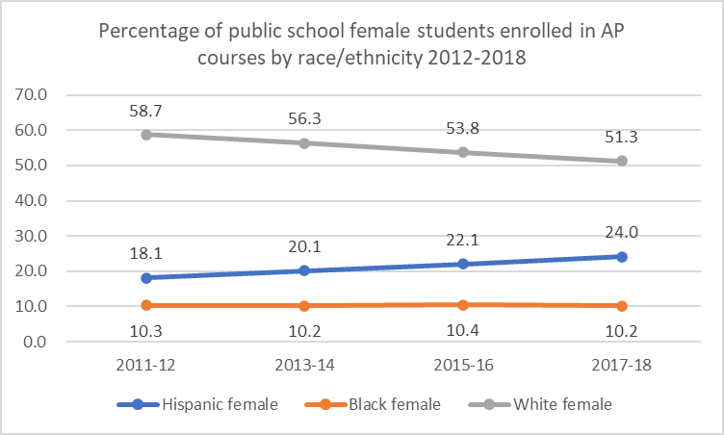
Female Students Enrolled in AP Courses by Race

Slide 15
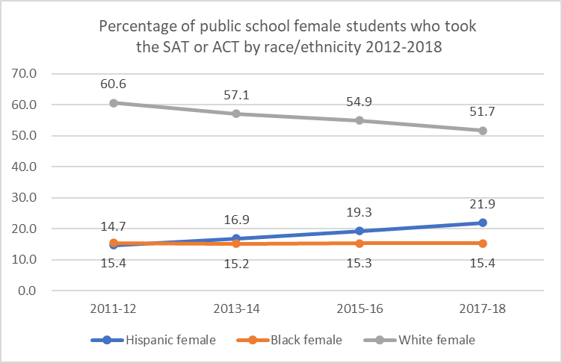
Female Students Who Took SAT or ACT by Race

Slide 16
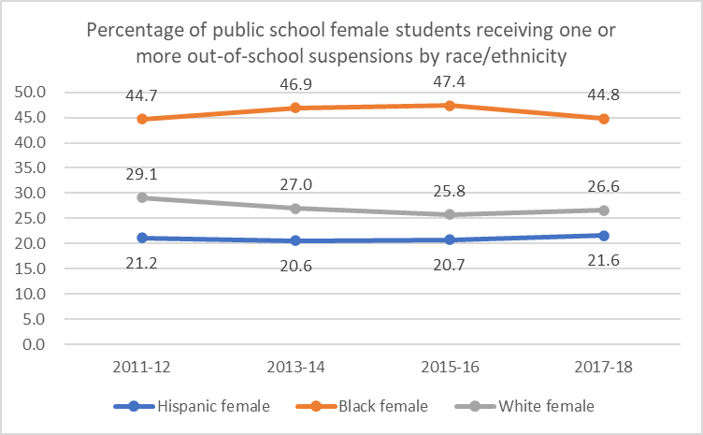
Female Students Receiving One or More Out-of School Suspensions by Race

Slide 17
CGCS KPI Data: 2016-2019
Data provided on member districts only.

Slide 18
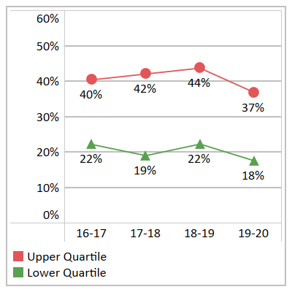
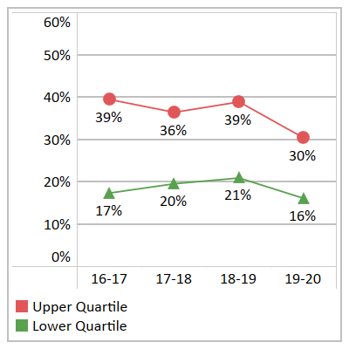
Ninth Grade Course Failures
Black and Hispanic Females
Black Female Ninth Grade Course Failures by Quartile, 2016-17 to 2019-20
Hispanic Female Ninth Grade Course Failures by Quartile, 2016-17 to 2019-20

Slide 19
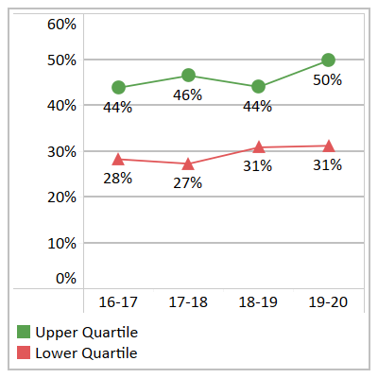
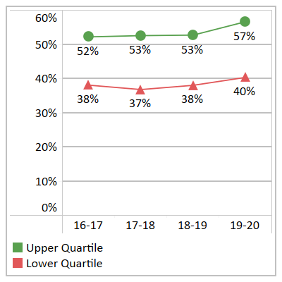
Ninth Grade Students with a “B” Average or Better
Black and Hispanic Females
Black FEMale Ninth Grade Students with B Average GPA or Better in All Courses by Quartile, 2016-17 to 2019-20
Hispanic FEMale Ninth Grade Students with B Average GPA or Better in All Courses by Quartile, 2016-17 to 2019-20

Slide 20
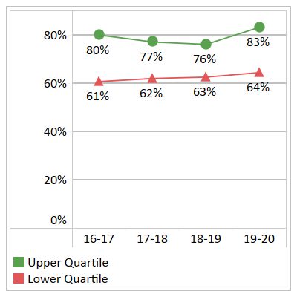
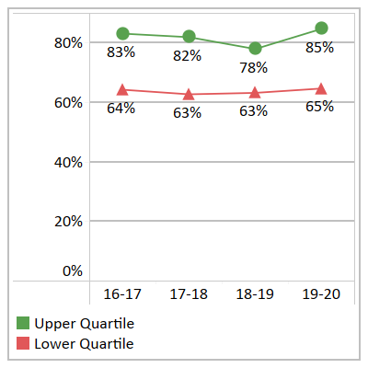
Algebra I/Integrated Math Completion Rates
Black and Hispanic Females
Black feMales Who Completed
Algebra I/Integrated Math by the End of Ninth Grade by Quartile, 2016-17 to 2019-20
Hispanic feMales Who Completed
Algebra I/Integrated Math by the End of Ninth Grade by Quartile, 2016-17 to 2019-20

Slide 21
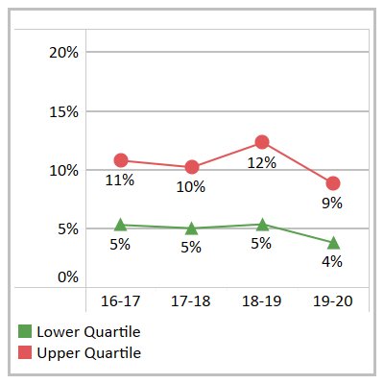
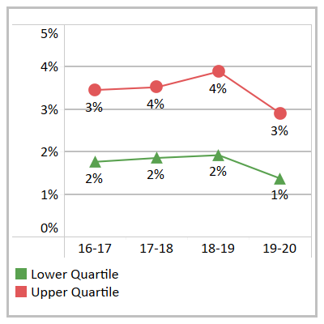
Out of School Suspensions
Black and Hispanic Females
Out-of-School Suspensions Among Black feMales by Quartile, 2016-17 to 2019-20
Out-of-School Suspensions Among Hispanic feMales by Quartile, 2016-17 to 2019-20

Slide 22
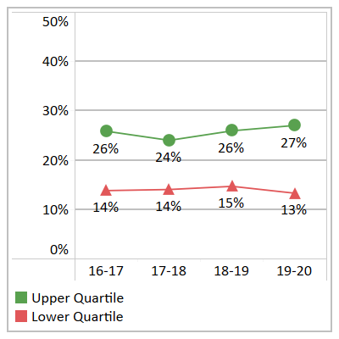
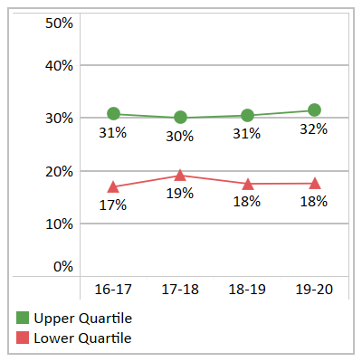
Students Who Took One or More AP Courses
Black and Hispanic Females
Black FeMale Secondary Students Who Took One or More AP Courses by Quartile, 2016-17 to 2019-20
Hispanic feMale Secondary Students Who Took One or More AP Courses by Quartile, 2016-17 to 2019-20

Slide 23
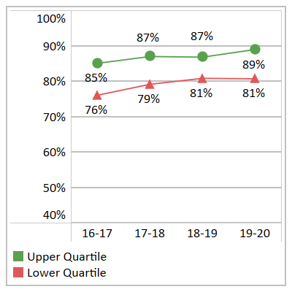
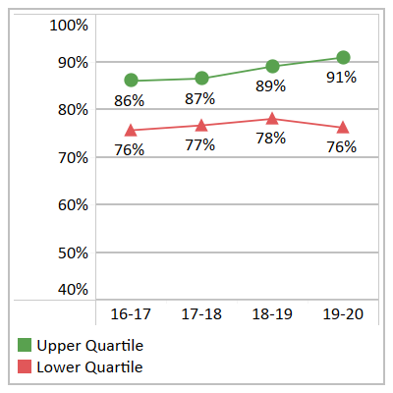
Cohort Graduation Rates
Black and Hispanic Females
Four-Year Cohort Graduation Rates for Black feMales by Quartiles, 2016-17 to 2019-20
Four-Year Cohort Graduation Rates for Hispanic feMales by Quartiles, 2016-17 to 2019-20

